Slide 1
CSE Course: STAT-2111 Course title: Theory of Statistics
Prof. Md. Aminul Hoque, PhD
HP: 01715361973
E-mail: aminul@ru.ac.bd
OR
mdaminulh@gmail.com

Slide 2
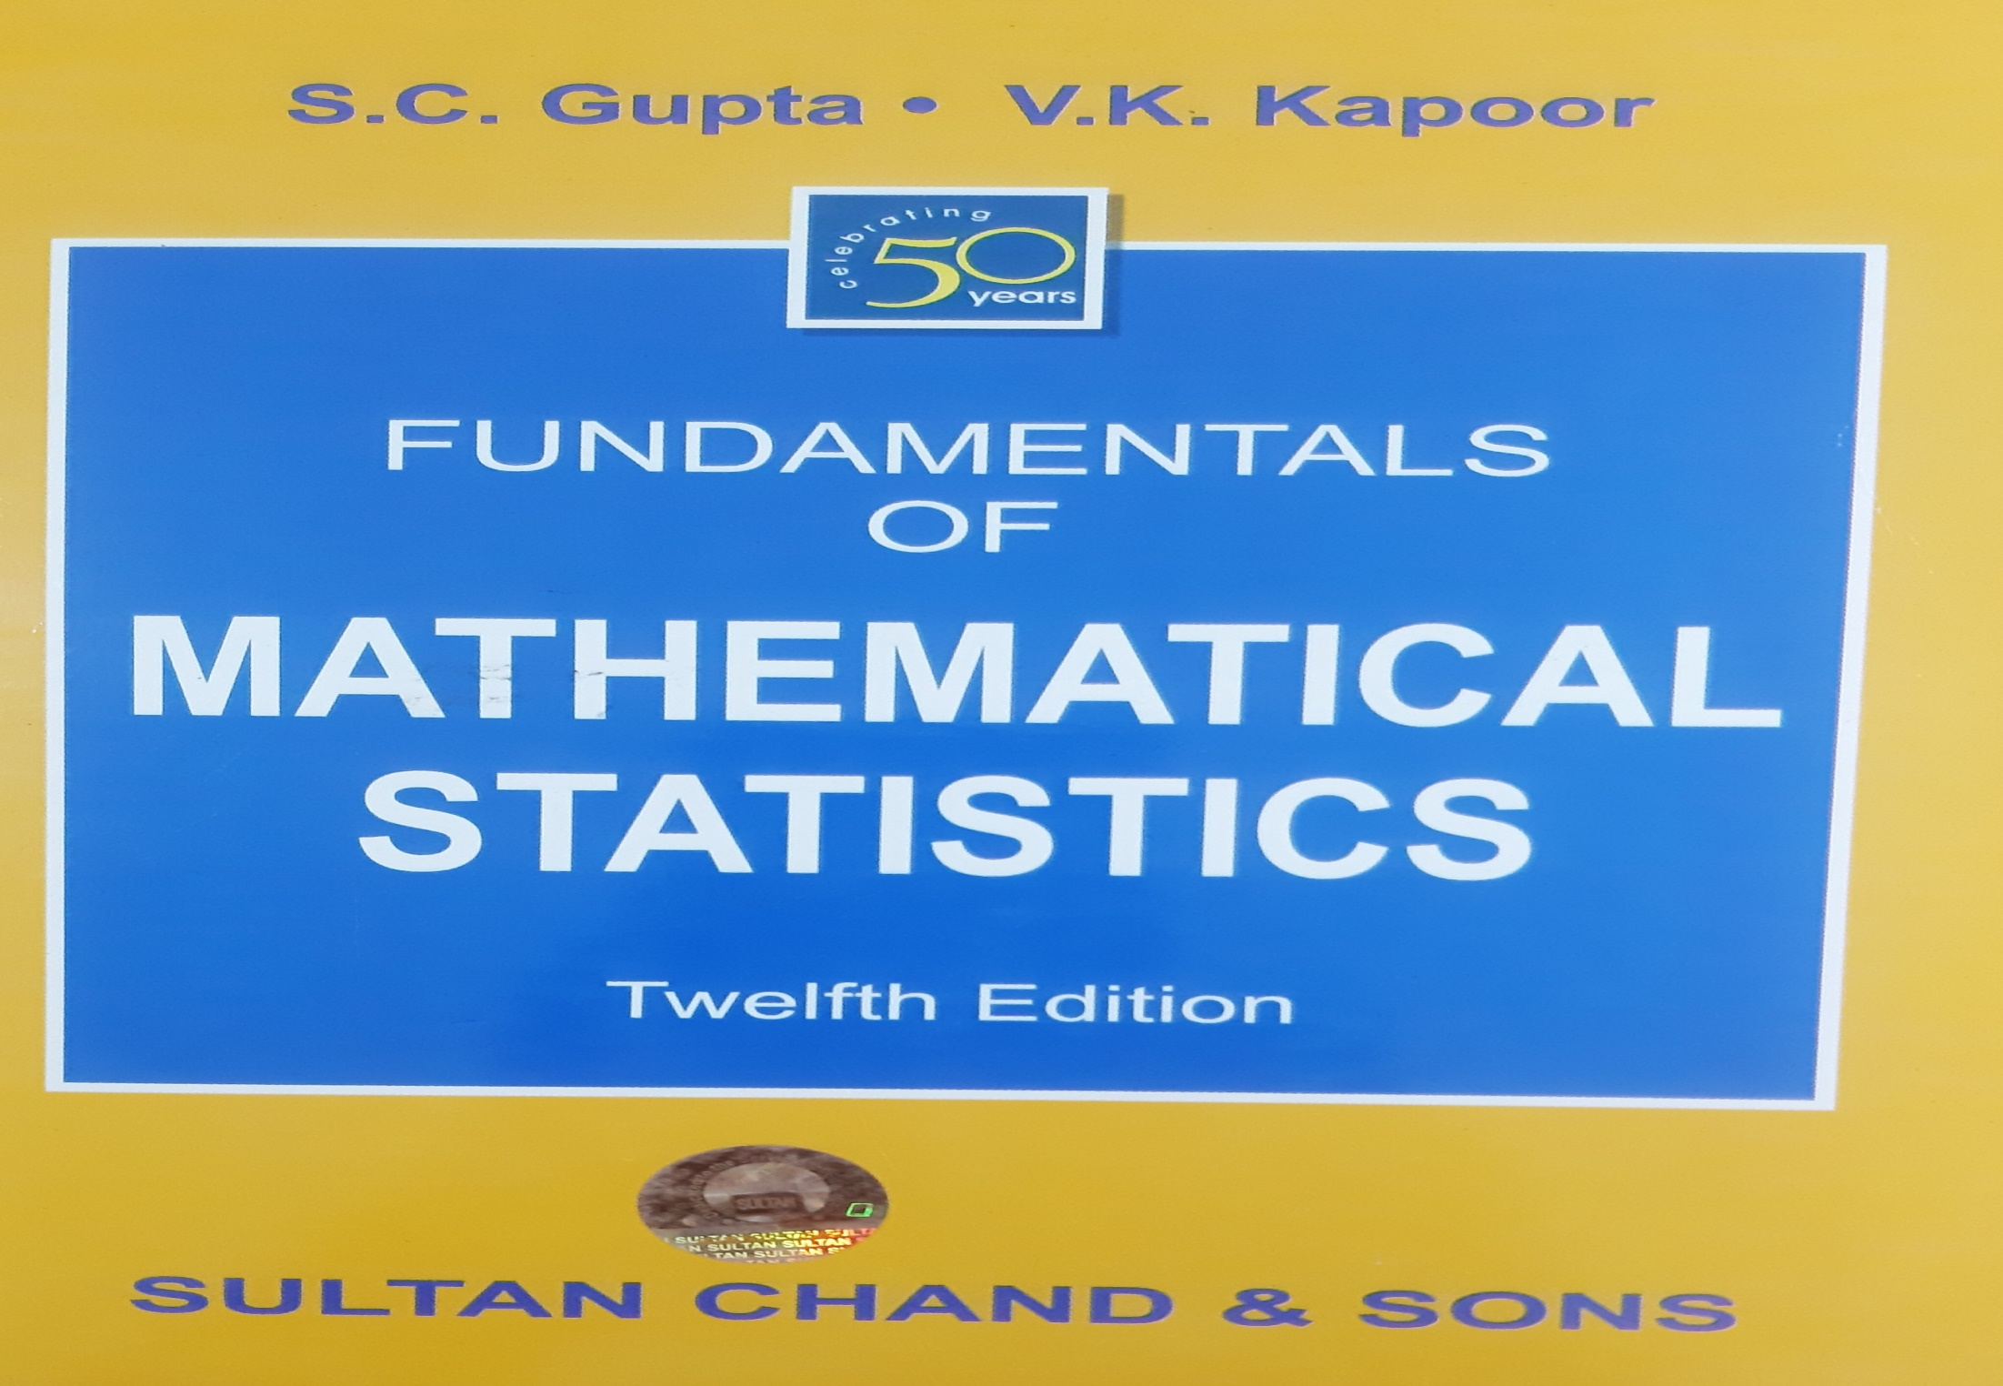
Reference

Slide 3
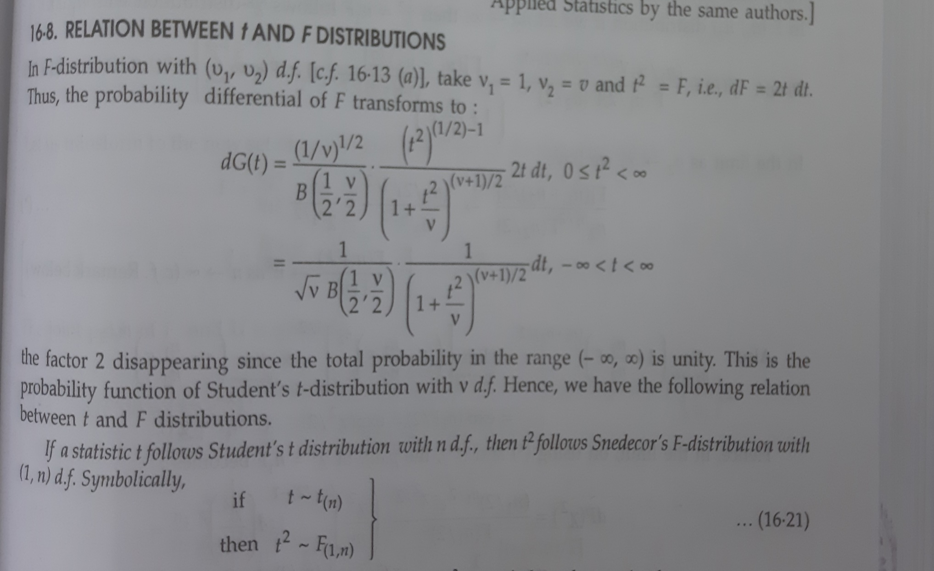
Relation between t and F distribution

Slide 4
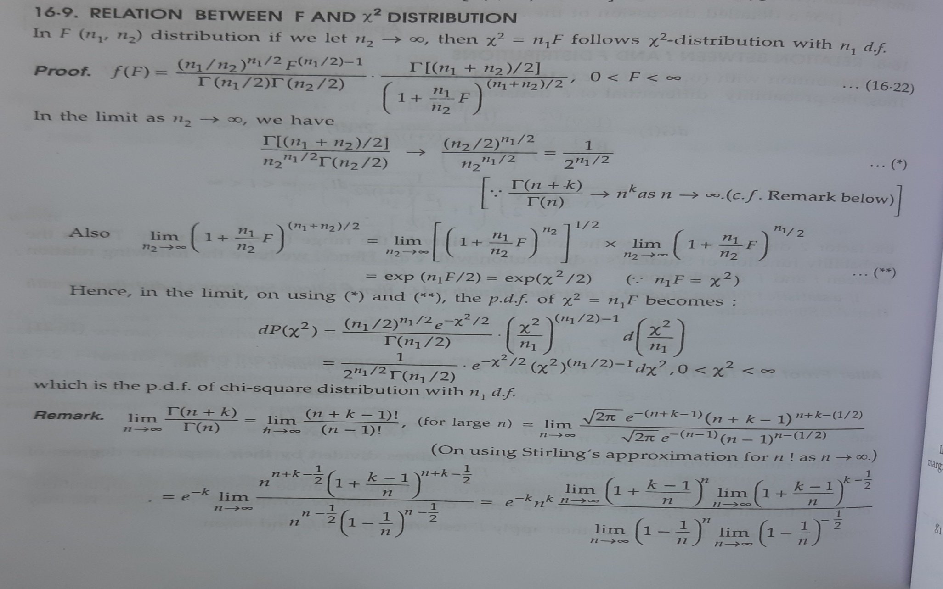
Relation between Chi-square and F distribution

Slide 5
